Slide 1
FITNESS AROUND ME
Group Members – Nikhil Mali(220343120066)
Asawari Patil (220343120071)
Pavan Bhujbal (220343120024)
Prajakta Garad (220343120080)
Project Guide – Mrs. Harshita Maheshwari

Slide 2
Contents
Introduction
Choice of topic
Proposed System
Methodology
Proposed System Model
Proposed Approach
Screenshot
System Requirements
Applications
Advantages & Limitations
Conclusion
Future Scopes
References

Slide 3
Introduction
Fitness Around Me is a web application is an attempt to simulate basic concepts of Fitness Centers System
This application provides a platform for a user to find Fitness Center .
It provides user, owner login.
Owners can register centers
Users can access the details of those centers according to location.

Slide 4
Choice of topic
Through this project users get details of different types of Fitness centers under same roof.
Easy & Fast
Advertisement Page
Owners get a platform to showcase the details of their centers.

Slide 5
Proposed System
AIM:
1. It will help End user
Proposed System:
1. Digitalize Fitness application
2. Communication can take place even through mobile
3. Eliminate Intermediates
4. Availability of choosing different types of centers.

Slide 6
Methodology
The objective is to create a web site that can perform the following:-
Opening the relevant HTML page using HTTPS POST & GET methods.
Read the data logically into user , centers and owner.
Creating a local database.

Slide 7
Proposed System Model
There are three main modules:
User Owner
1 Home 1 Home
2 Profile 2 Profile
3 BMI Calculator 3 Add Center and Center List
4 Register and Login 4 Register and login
5 Log Out 5 Log Out

Slide 8
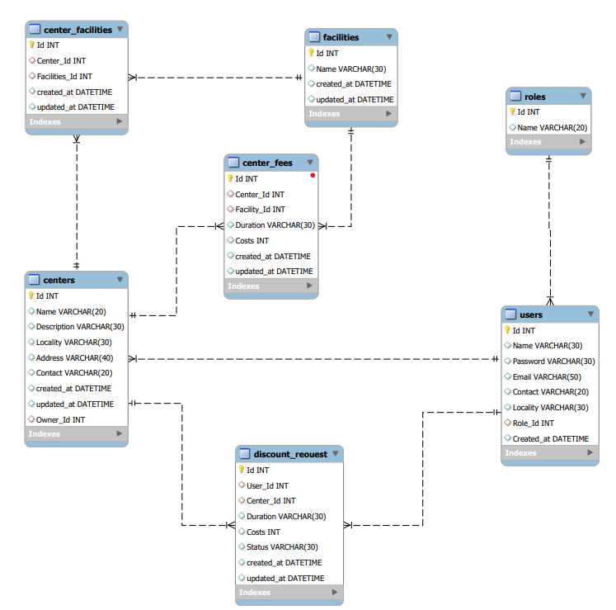
Proposed Approach

Slide 9
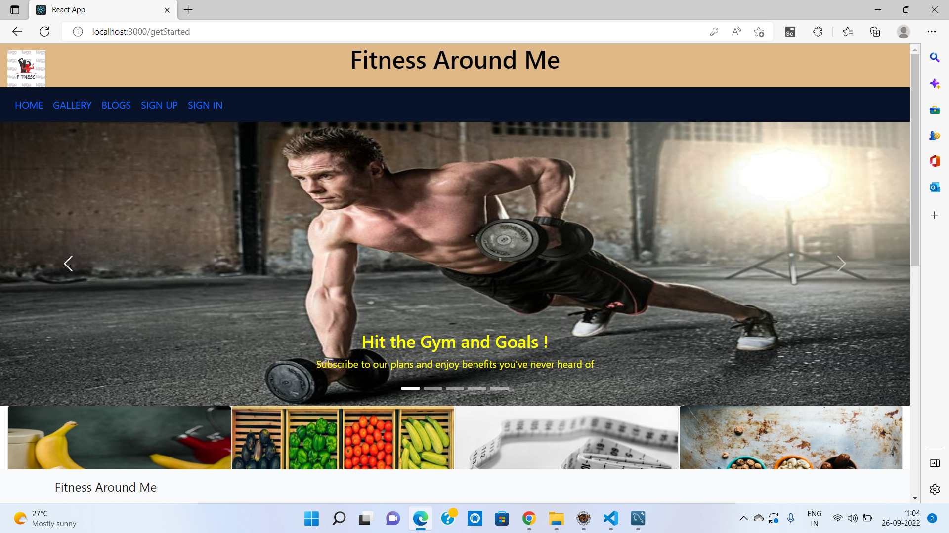
Screenshots

Slide 10
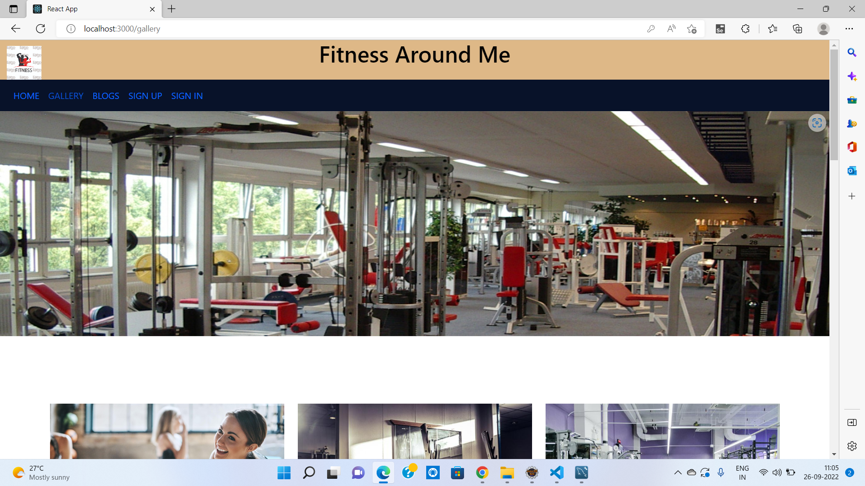

Slide 11
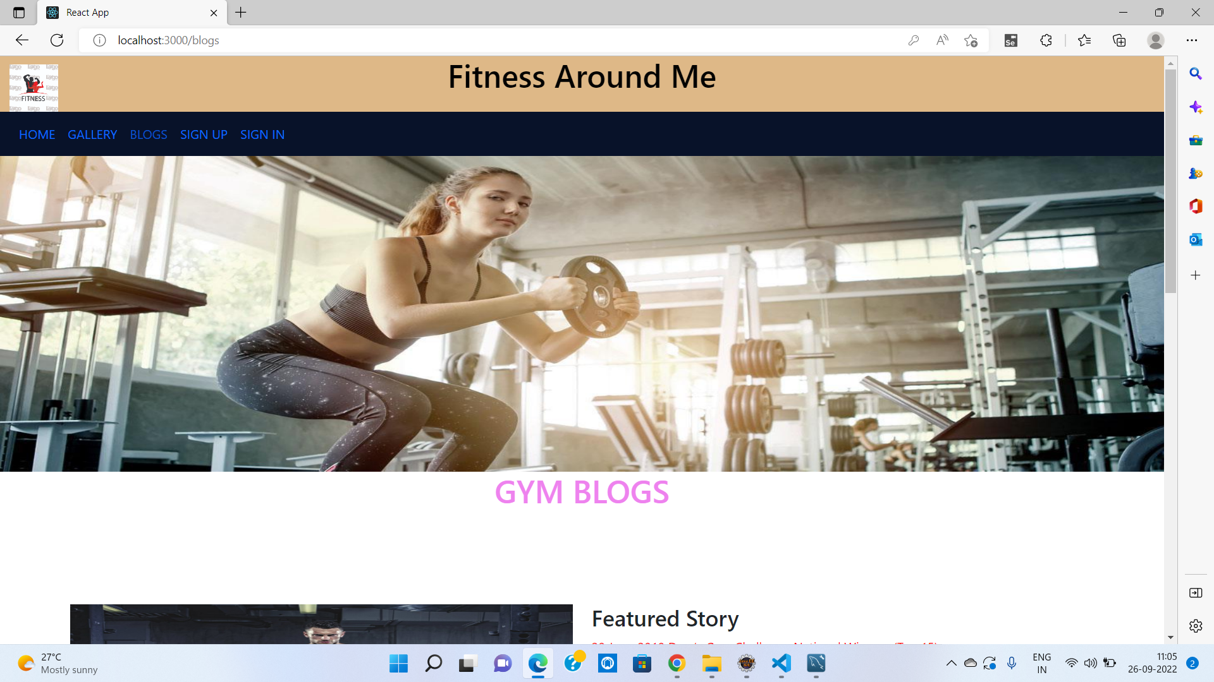

Slide 12
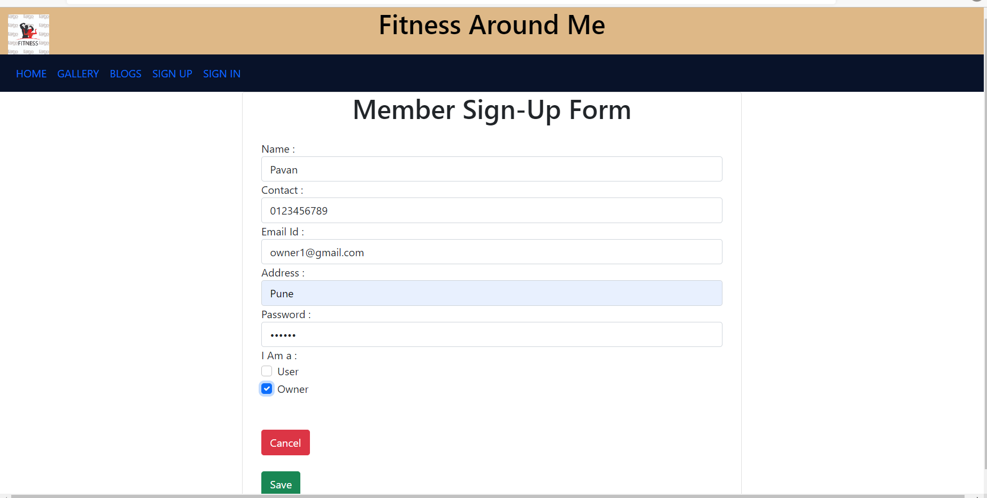

Slide 13
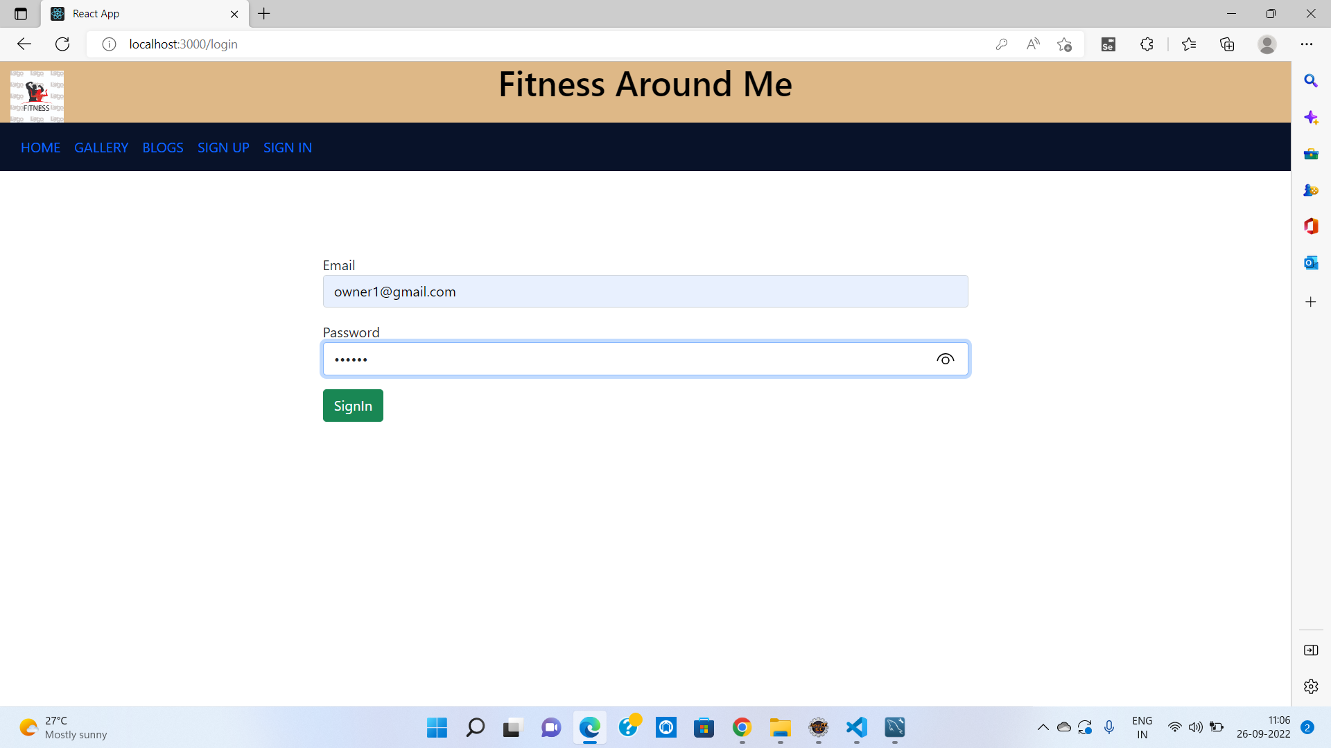

Slide 14
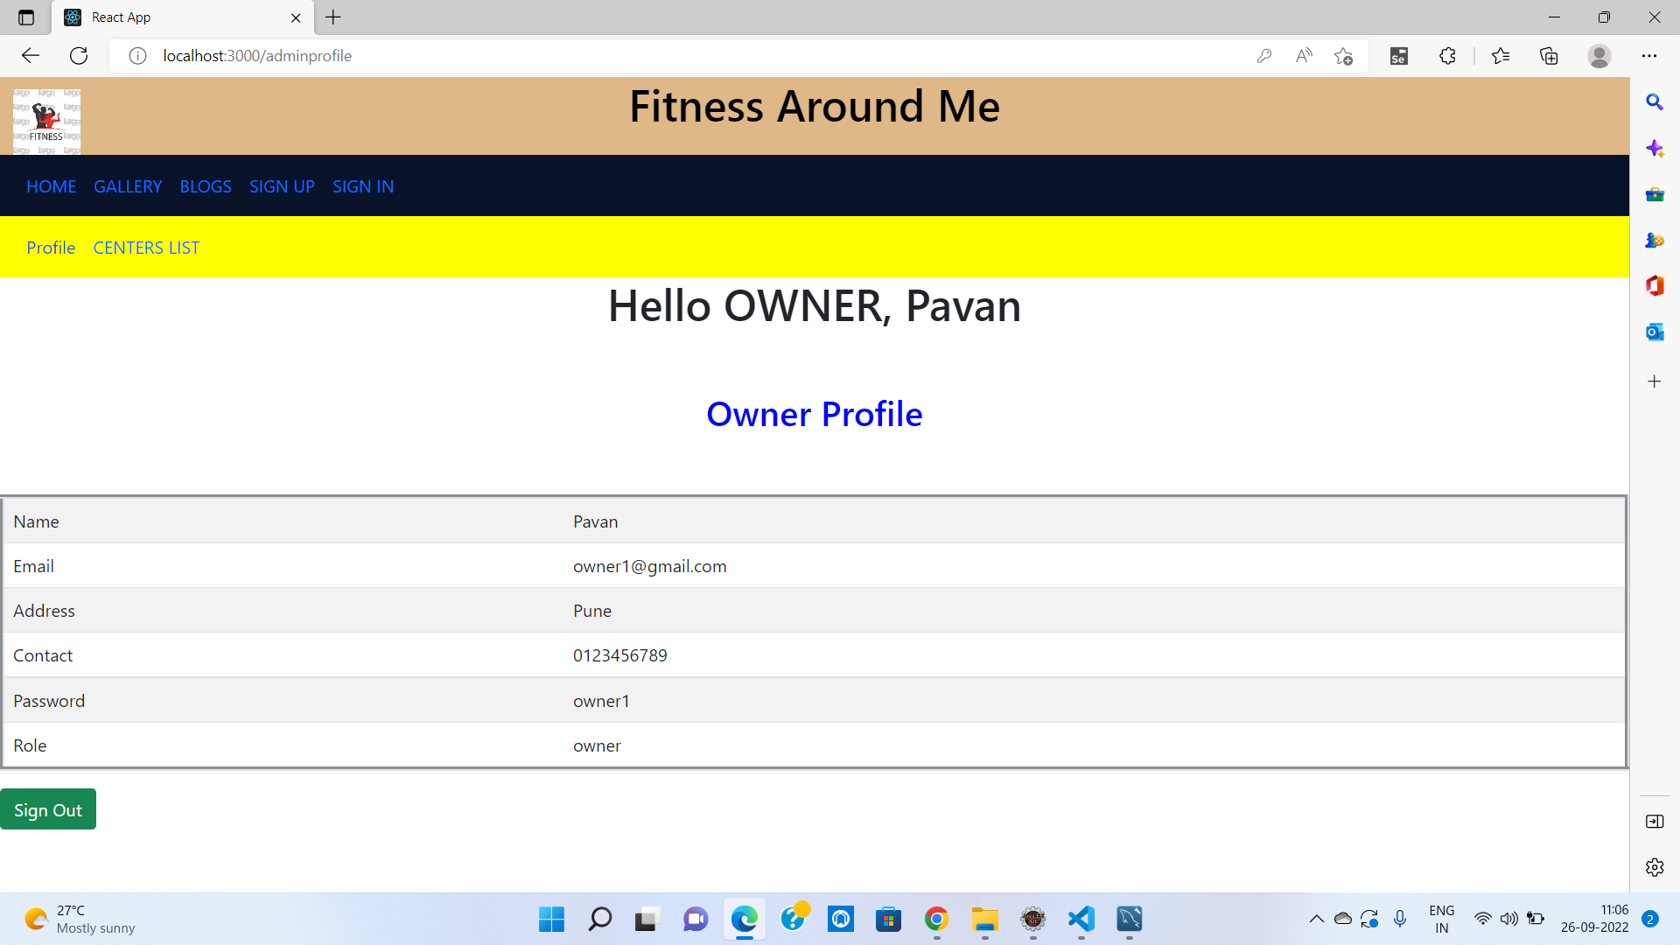

Slide 15
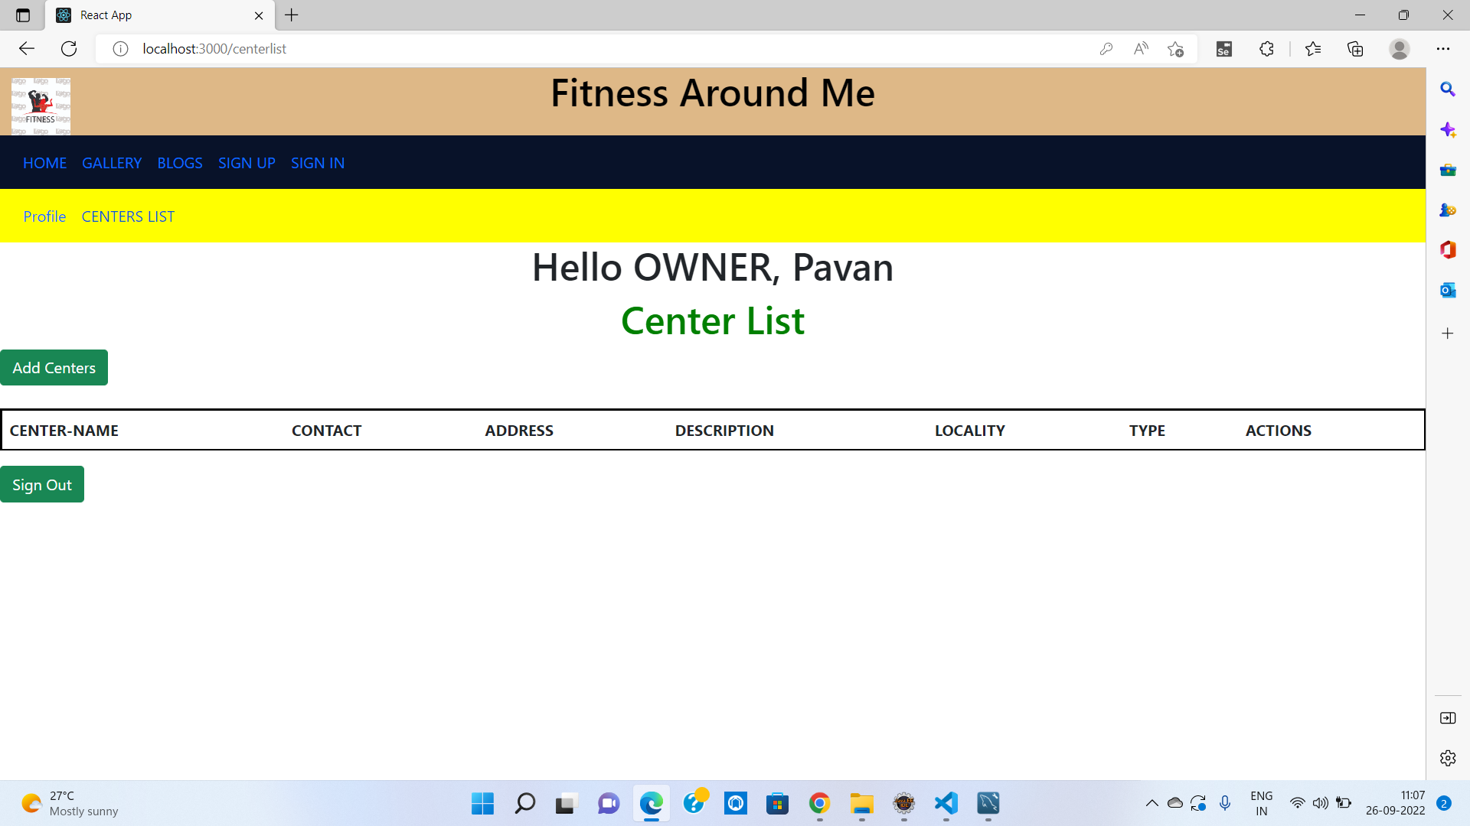

Slide 16
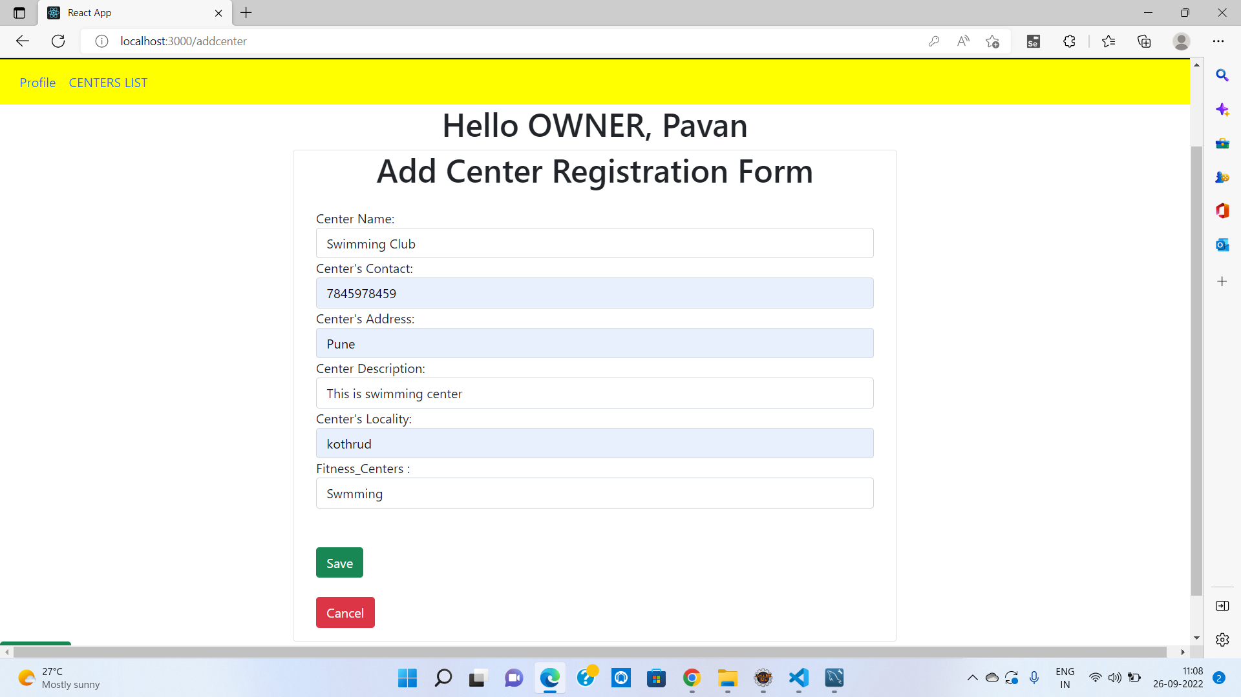

Slide 17
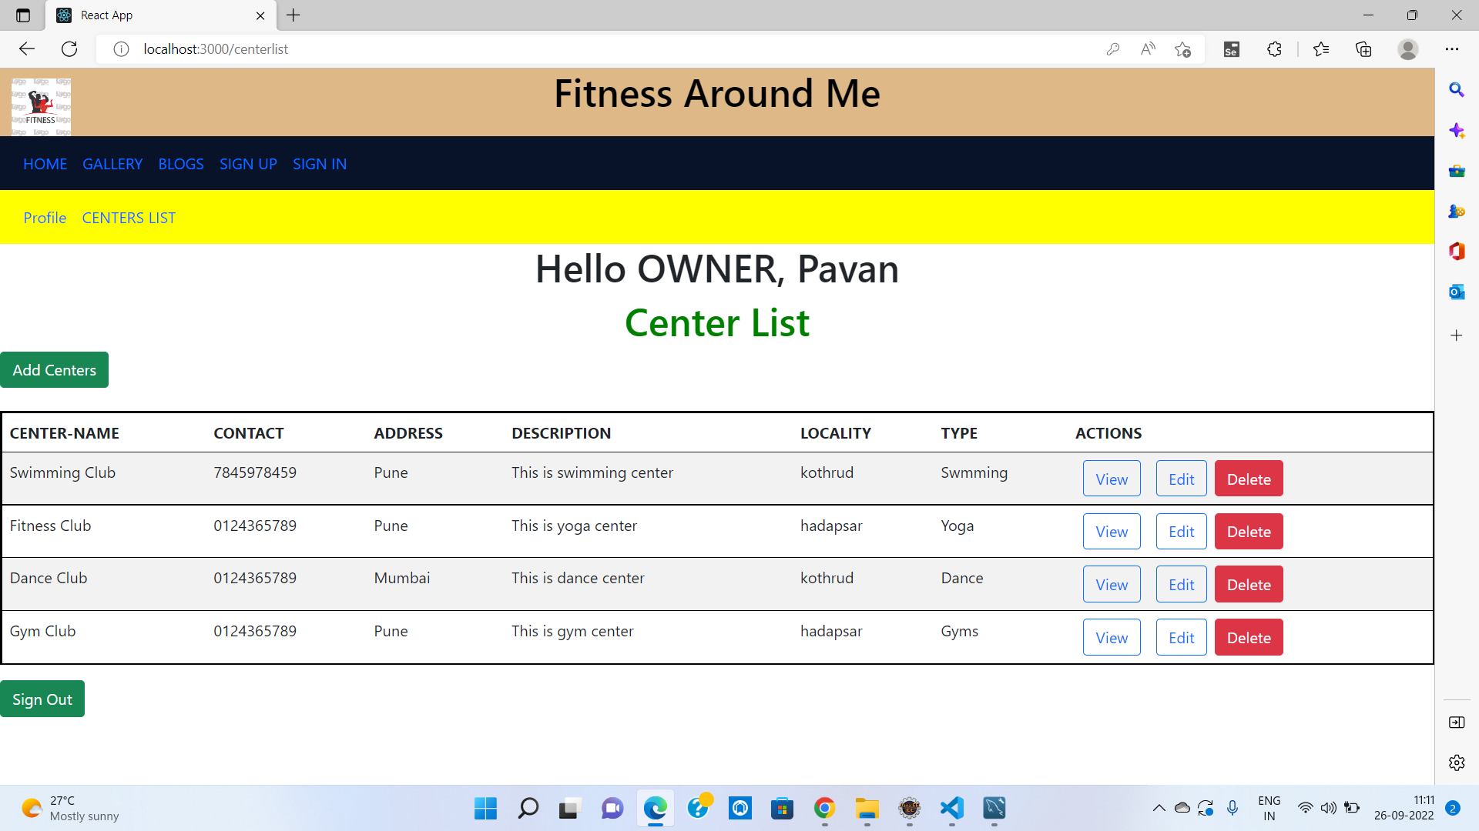

Slide 18
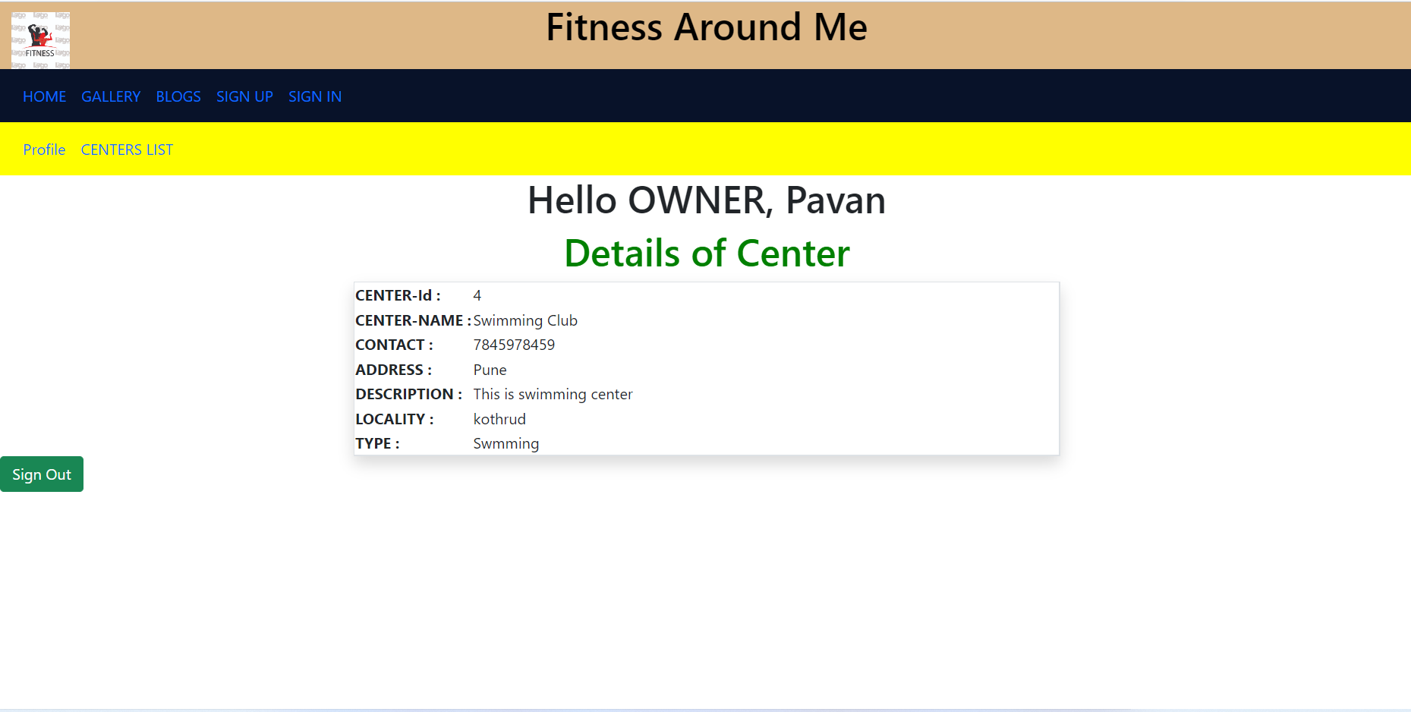

Slide 19
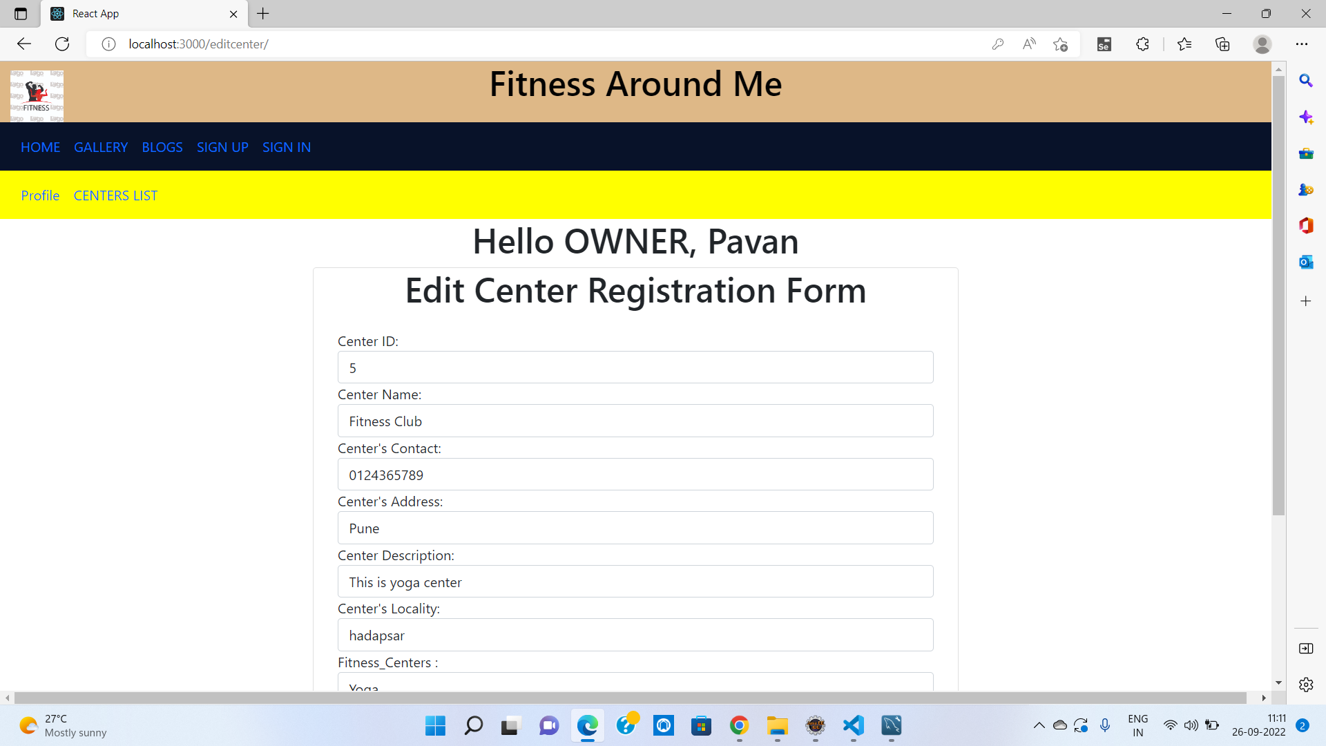

Slide 20
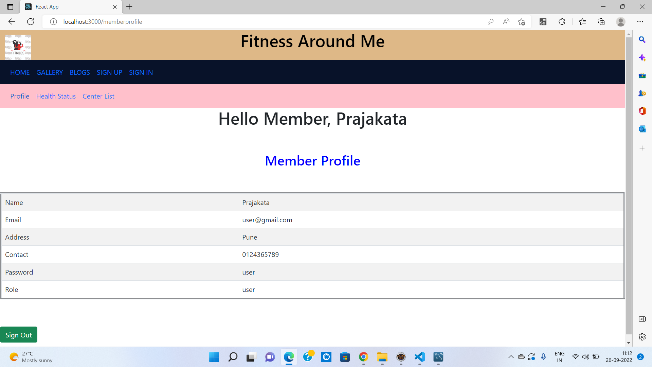

Slide 21
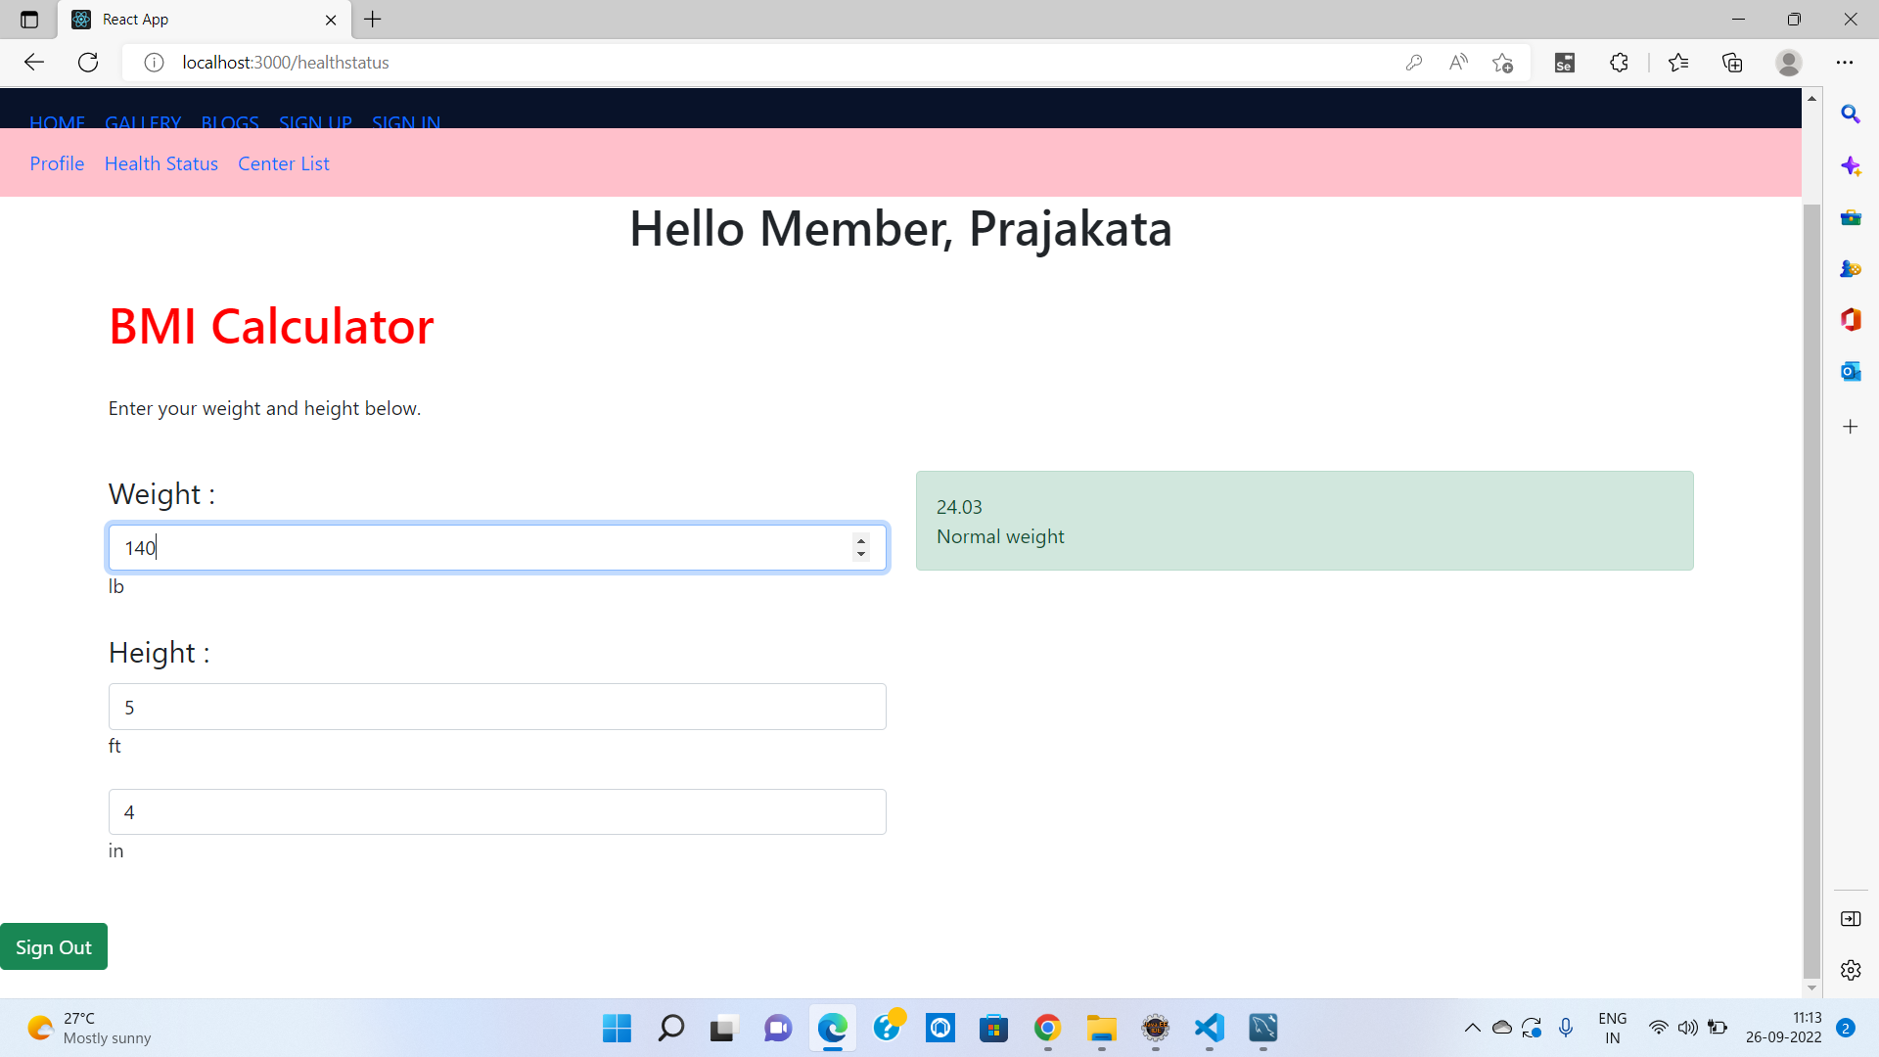

Slide 22
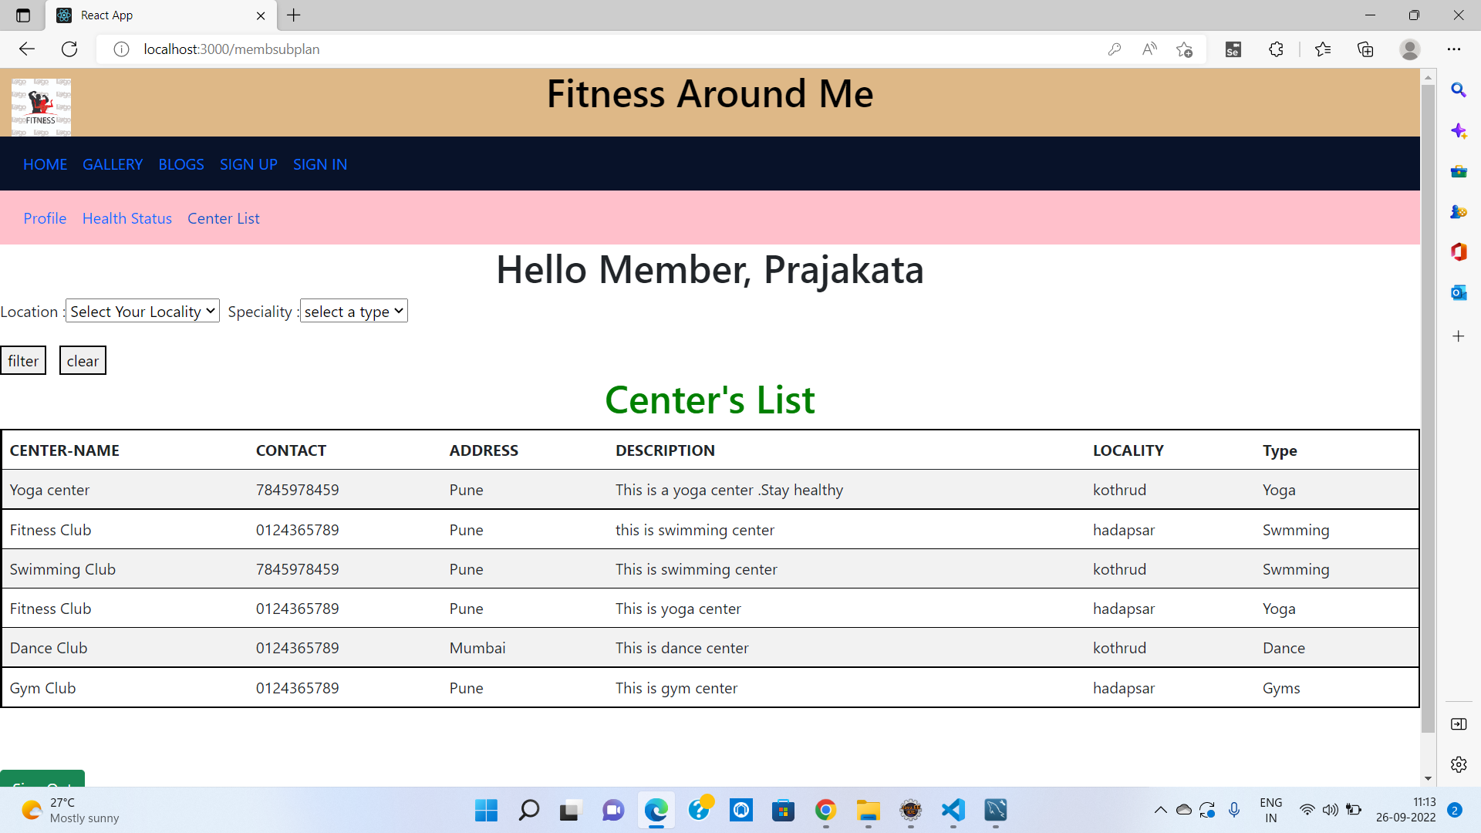

Slide 23
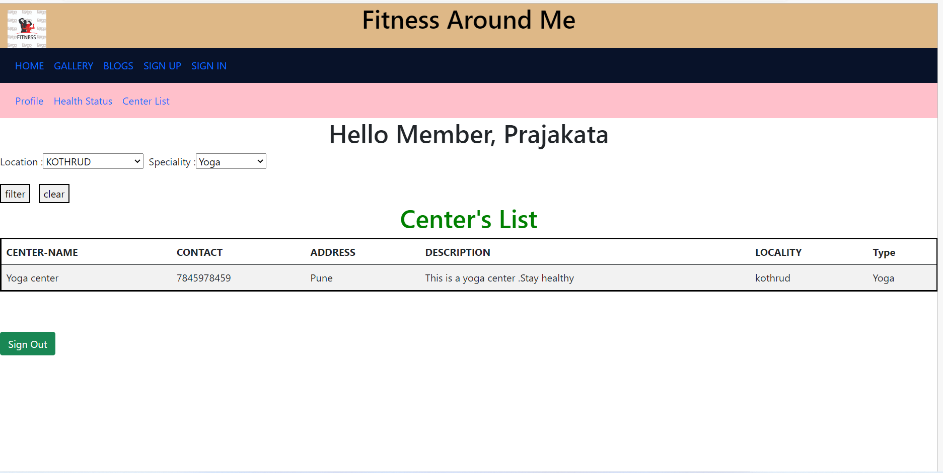

Slide 24
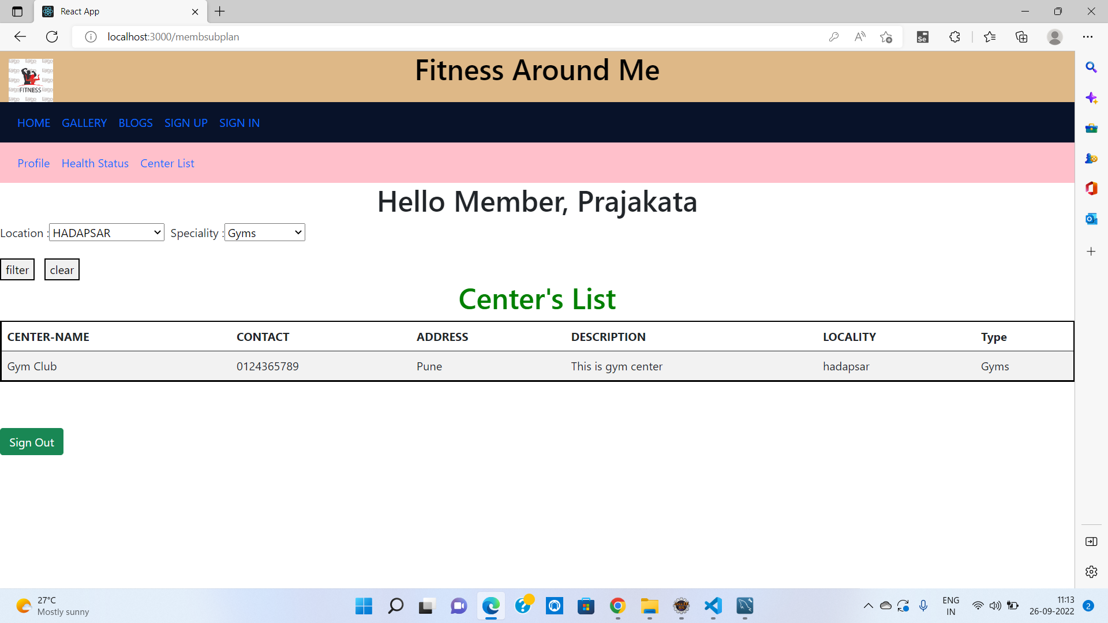

Slide 25
System Requirements
Software Requirements:
• Windows (All Versions)
• Tomcat 8.5
• Eclipse, MySQL, VSCode
Hardware Components:
• Processor – i3
• Hard Disk – 5 GB
• Memory – 1GB RAM

Slide 26
Technologies Used
HTML : Page Layout has been designed in HTML.
CSS : Used for all designing part.
JavaScript : All Validation task and animations has been developed by JS.
JSP : All front end logic has been written in JSP.
JAVA : All the business logic has been written in JAVA.
MySQL : MySQL database has been used as database.
Tomcat : Project will run using Tomcat server.

Slide 27
Applications
Digital search of Fitness Centers
Can be used in other countries
Advertisement

Slide 28
Advantages
Transparency in the system.
Saves Time, cost and energy.
Users can easily access the details of nearby fitness centers and have an option to check health status required in fitness centers.
Owners in locality get an platform to advertise and attract more customers to their fitness centers.

Slide 29
Limitations
Accurate verification of the users cannot be done online.
It requires an extensive database and memory.

Slide 30
Conclusion
The Fitness Around me web service will be designed and developed to overcome the drawbacks of old manual system and meet the requirement of modern age. This system will digitalize the whole searching and filtering of fitness centers for users and will create a platform for owners . It will bring transparency between users and owners by removing intermediates. It will save time & energy of everyone using this portal. Lastly it can be improved in future according to rising demand of users.

Slide 31
Future Scope
Verification of users.
Improvement in design.
Membership , inquiry ,Google map integration
UPI payment
Integration of new function like training video, online classes , diet planning
Chat BOT

Slide 32
References
Mr. Saleel Bagde for Database.
Mrs. Harshita Maheshwari for HTML JS & CSS also she was our project guide.
Mr. Raju Kolhe for JSP & JAVA.
https://www.slideshare.net
https://www.projectideas.co.in
https://www.fitternity.com/
A special thanks to Infoway Management who arranged extra lab time for us.

Slide 33
THANK YOU

